Slide 1
Lecture 2
Riddles

Slide 2
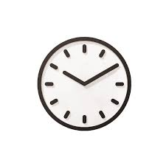
Overlaps
How many times a day do a clock’s hands(hour and minute hands only) overlap?

Slide 3
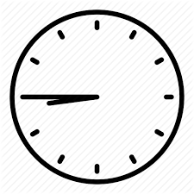
Mirror image
A clock seen through a mirror reads a quarter to nine. What is the actual time?

Slide 4
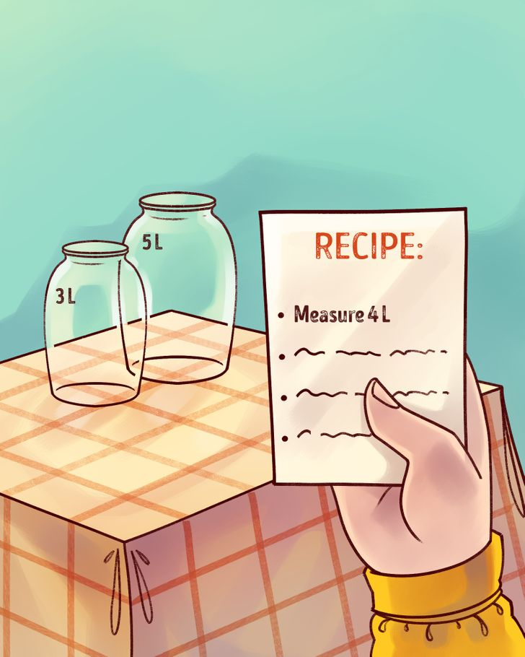
Measure water
You have unlimited access to water and two jars: 5 L and 3 L. Measure 4 liters precisely

Slide 5
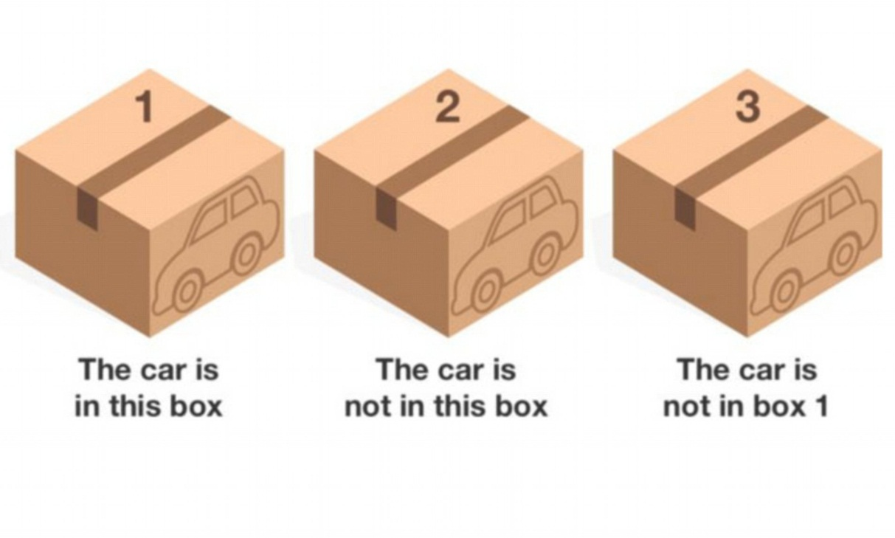
Car in the box
There are 3 boxes. One of them has a toy car that you get to keep. On each box there is a statement. You know that in given situation, only one of the statements is true. Which box has the car?

Slide 6
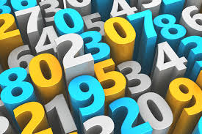
Numbers
A detective who was mere days away from cracking an international oil smuggling ring has suddenly gone missing. While inspecting his last known location, officers find a note: 710 57735 34 5508 51 7718.
Currently there are three suspects: Bill, John, and Todd. Can you break detective’s code and the criminal’s name?

Slide 7

Rich people
A man is found murdered on a Sunday morning. His wife calls the police, who question the wife and the staff. The wife says she was sleeping, the butler was cleaning the closet, the gardener was picking vegetables, the driver went to bank for paying electricity bill. The cook was preparing breakfast. Immediately, the police arrested the murderer. Who did it and how did the police know?

Slide 8

XYZ
A car's number plate contains three digits XYZ whose product is 32.
With the following information can you identify the complete number:
the first and the last digits are same
the middle digit is the largest of all

Slide 9
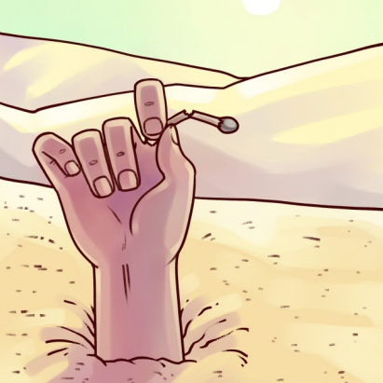
Dead man and a match stick
A man is found in the desert dead. In his hand is half of a match. How did he get there and how did he die? Make an interesting story out of this situation

Slide 10
Solutions

Slide 11
Overlaps
How many times a day do a clock’s hands (hour and minute hands only) overlap?

Slide 12
Answer: 22 times
AM | PM
12:00 1:05 2:11 3:16 4:22 5:27 6:33 7:38 8:44 9:49 10:55 | 12:00 1:05 2:11 3:16 4:22 5:27 6:33 7:38 8:44 9:49 10:55

Slide 13
Mirror image
A clock seen through a mirror reads a quarter to nine. What is the actual time?

Slide 14
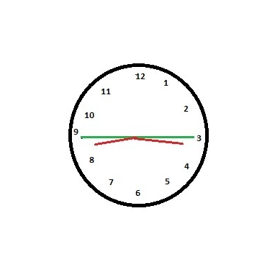
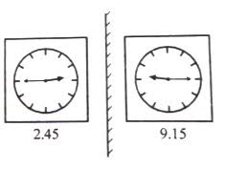
Answer

Slide 15
Measure water
You have unlimited access to water and two jars: 5 L and 3 L. Measure 4 liters precisely

Slide 16
Answer
• Fill the 5-liter jar with water, and use it to fill the 3-liter jar. Then empty the 3 liter jar. Now you have 2 liters left in 5-liter jar. take the 5-liter jar, and pour the remaining 2 liters into the 3-liter jar. Then fill the 5-liter jar again, and pour the water (1 liter) into the 3-liter jar until you fill it.
• Thus, you’ll get 4 liters of water in the 5-liter jar

Slide 17
Car in the box
There are 3 boxes. One of them has a toy car that you get to keep. On each box there is a statement. You know that only one of the statements is true. Which box has the car?

Slide 18
Answer: Box # 2
If Box 1 then :
Statement of Box 1 true
Statement of Box 2 true
Statement of Box 3 false
If box 3 :
Statement of Box 1 false
Statement of Box 2 true
Statement of Box 3 true

Slide 19
Numbers
A detective who was mere days away from cracking an international oil smuggling ring has suddenly gone missing. While inspecting his last known location, officers find a note: 710 57735 34 5508 51 7718.
Currently there are three suspects: Bill, John, and Todd. Can you break detective’s code and the criminal’s name?

Slide 20
Answer: Bill
Bill is the suspect, if read upside down the numbers read:

Slide 21
Rich people
A man is found murdered on a Sunday morning. His wife calls the police, who question the wife and the staff. The wife says she was sleeping, the butler was cleaning the closet, the gardener was picking vegetables, the driver went to bank for paying electricity bill. The cook was preparing breakfast. Immediately, the police arrested the murderer. Who did it and how did the police know?

Slide 22
Answer: Driver
Banks remain closed on Sundays.

Slide 23
XYZ
A car's number plate contains three digits XYZ whose product is 32.
With the following information can you identify the complete number:
the first and the last digits are same
the middle digit is the largest of all

Slide 24
Answer
282

Slide 25
Dead man and a match stick
A man is found in the desert dead. In his hand is half of a match. How did he get there and how did he die? Make an interesting story out of this situation

